Slide 1
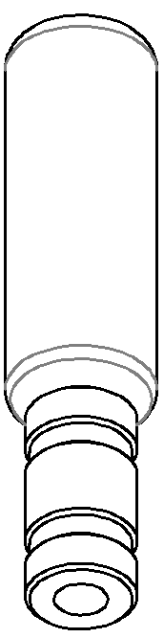

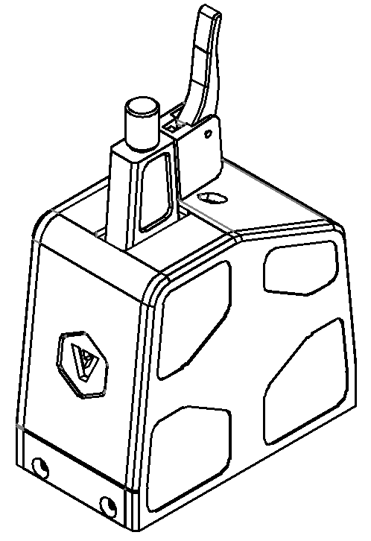
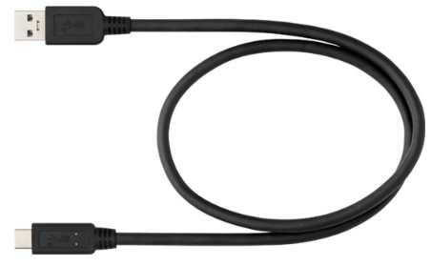
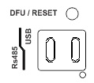
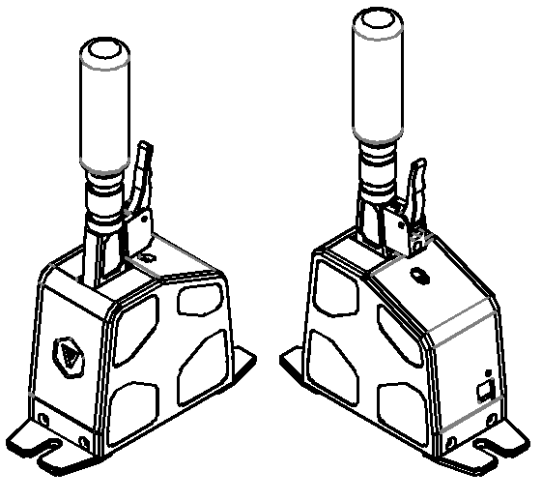
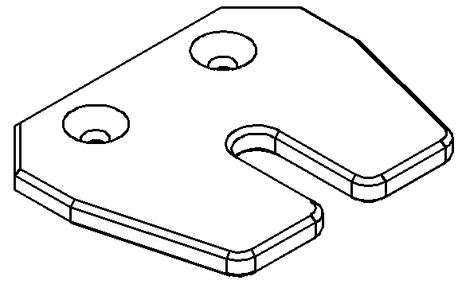

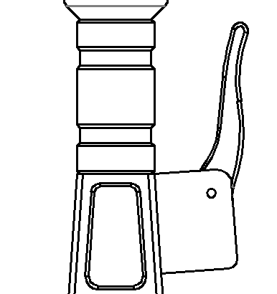
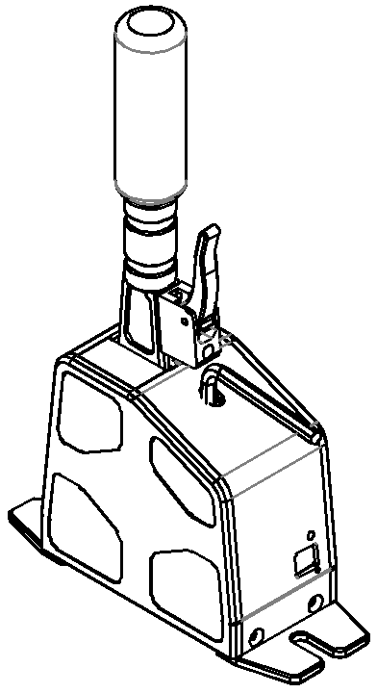
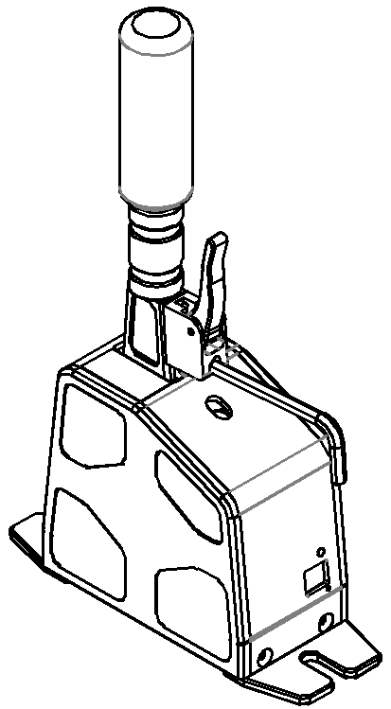
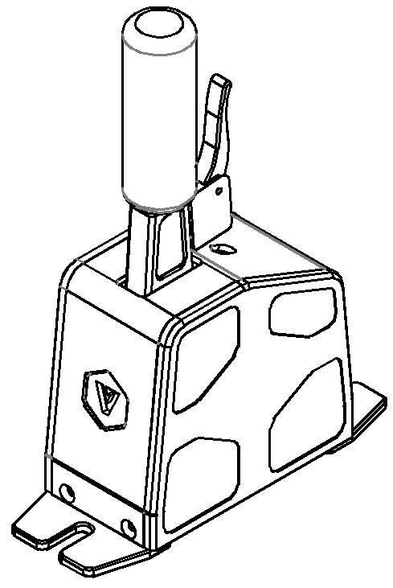

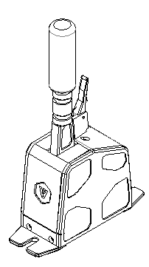

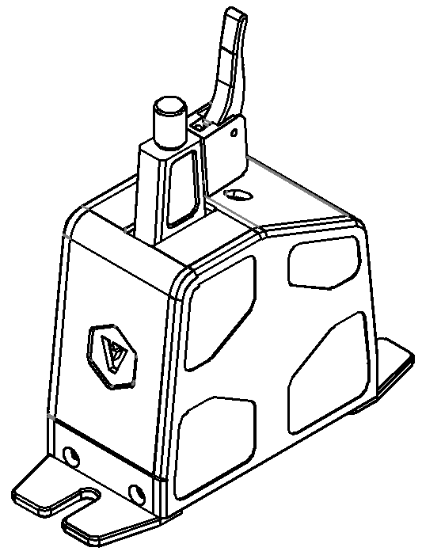
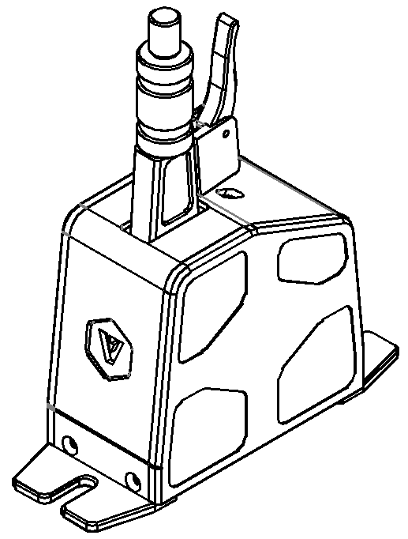
VNM SEQ SHIFTER
Quick Guide
Content
Connection
4
The connection is located on the shifter back.
2
1
Hold press to select DFU Mode (update firmware)/ Reset : quick press
3
5
Plug in type-C cable to connect to PC
X2
1. VNM Seq Shifter
2. Handle Extension
3. Shifter bracket & Mounting screws
4. USB type-C cable
5. Hexagon alley key
Neutral Quick Lever
Adjust Seq Shifter
1. Adjust Spring
2. Change Shifter Lever Length
Adjust Shifting Force
Adjust Neutral Quick Lever Force
Remove the Knob
Install Extension Lever
Install the Knob
Finish
Turn clockwise/counter-clockwise to increase/decrease the force

Slide 2
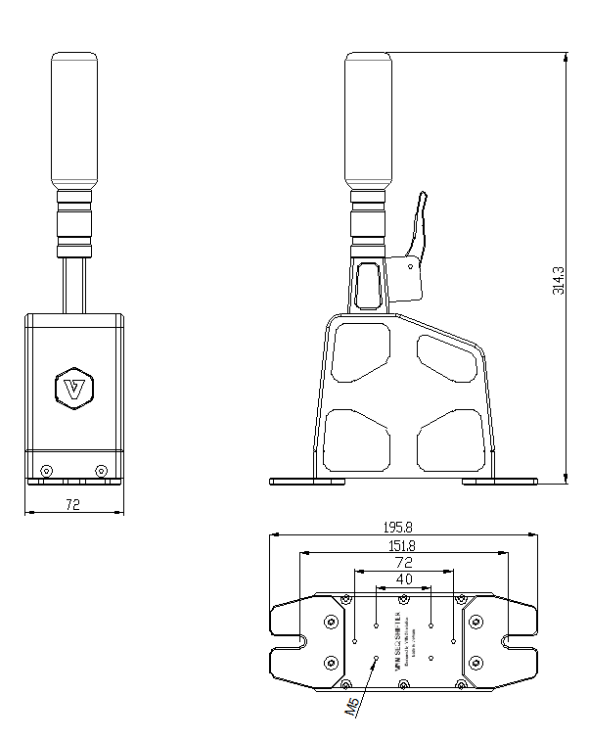
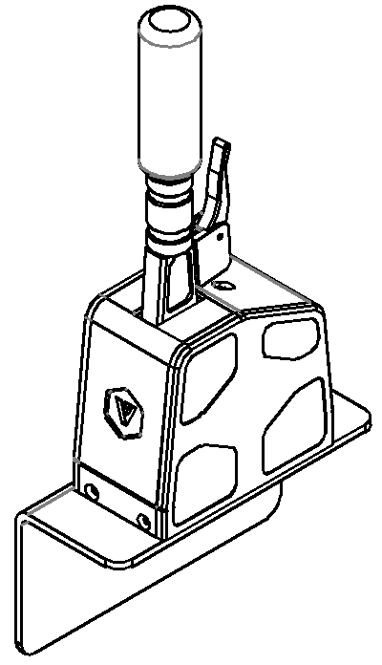
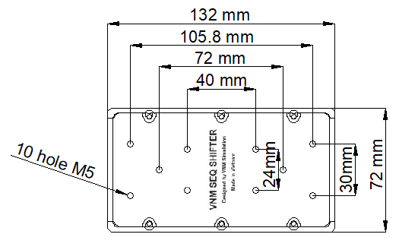
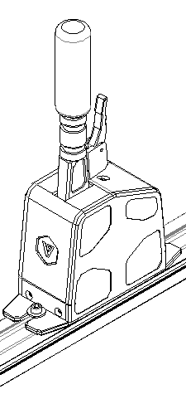
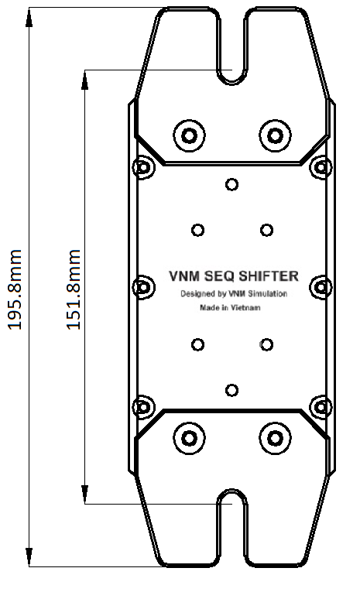
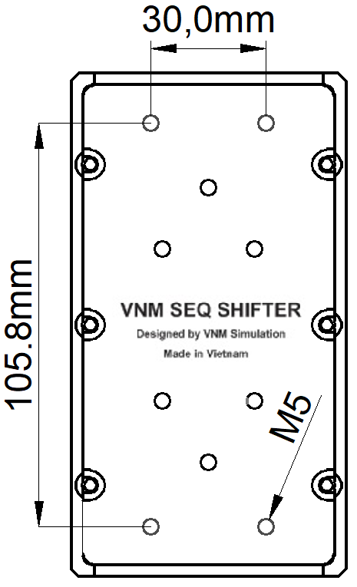
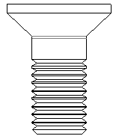
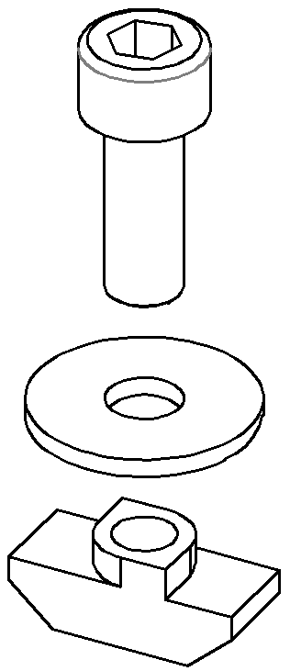
Mounting Solution
Shifter Dimension
1. Mount without bracket
2. Mount with brackets
M6x16
T-nut
M5x12
X4
X2
X2

